Slide 1
Liminal Spaces and the Uncanny Valley:
An Interdisciplinary Virtual Reality and Psychology Experimental Research Design
By: Ethan Wang, James Kerrane, Vincentius Aaron Chen
Notes:
Do Introductions on this page

Slide 2
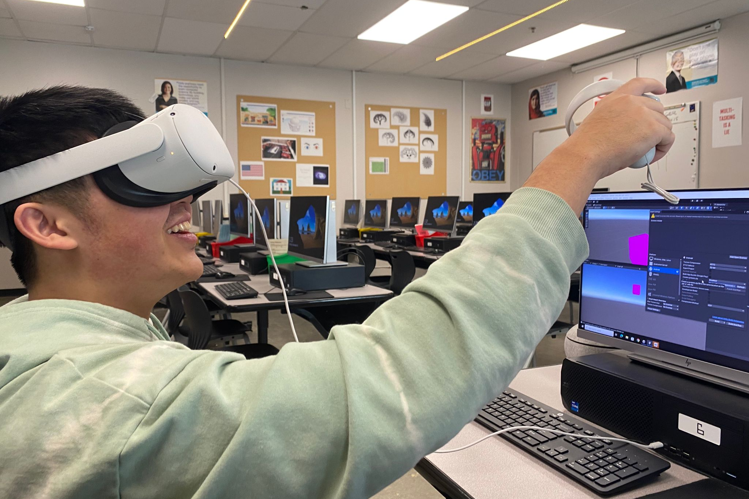
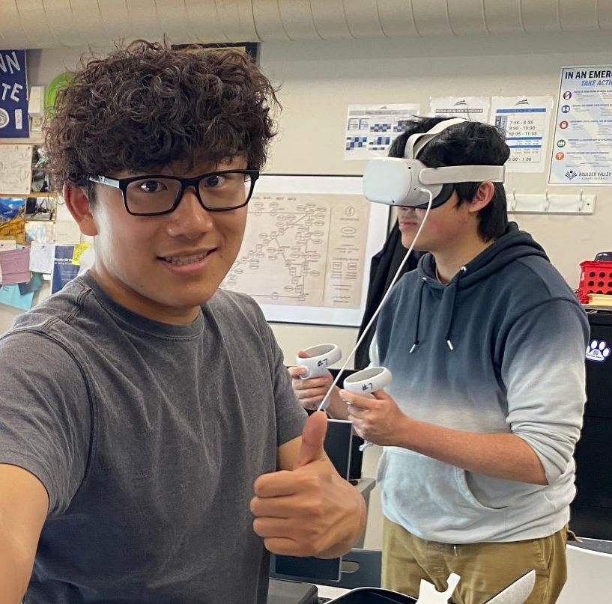
Project Overview
What are Liminal Spaces?
How are we using VR in this experiment?
What have we done to prepare for implementing this project?
What will the project look like/how will we collect data?

Slide 3
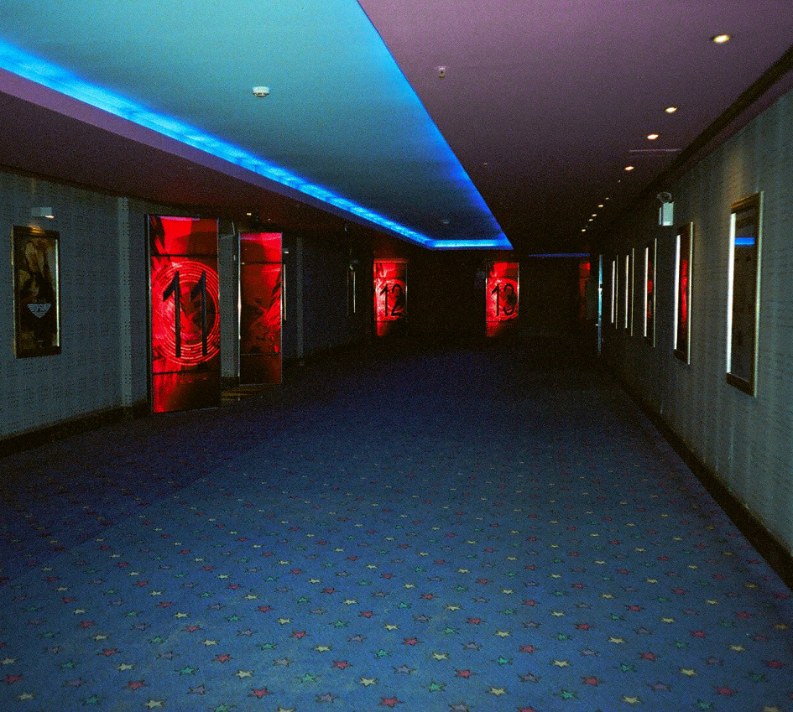
In Class Research Design Pitches
Research design brainstorming in class
Top pitch selection process
Reason for selecting liminal spaces
In class data collection

Slide 4
Research Question
How do the different orientations/organizations of objects within a space affect the comfort of those occupying that space?

Slide 5

Building in the Unity Game Engine

Slide 6



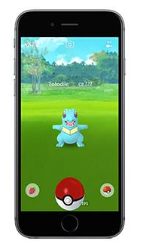


All made with Unity? sus…

Slide 7
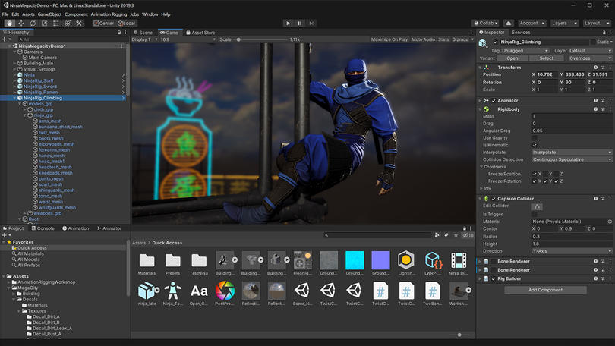
what we've been staring at for the past semester

Slide 8


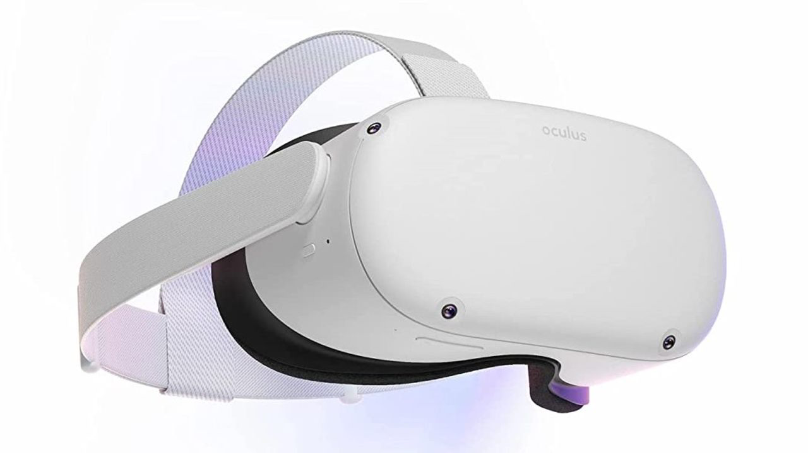
CDIP Grant
Career development and AP class enhancement
CDIP Grant
  10 VR Headsets
  Industry-Standard Unity Certifications

Slide 9
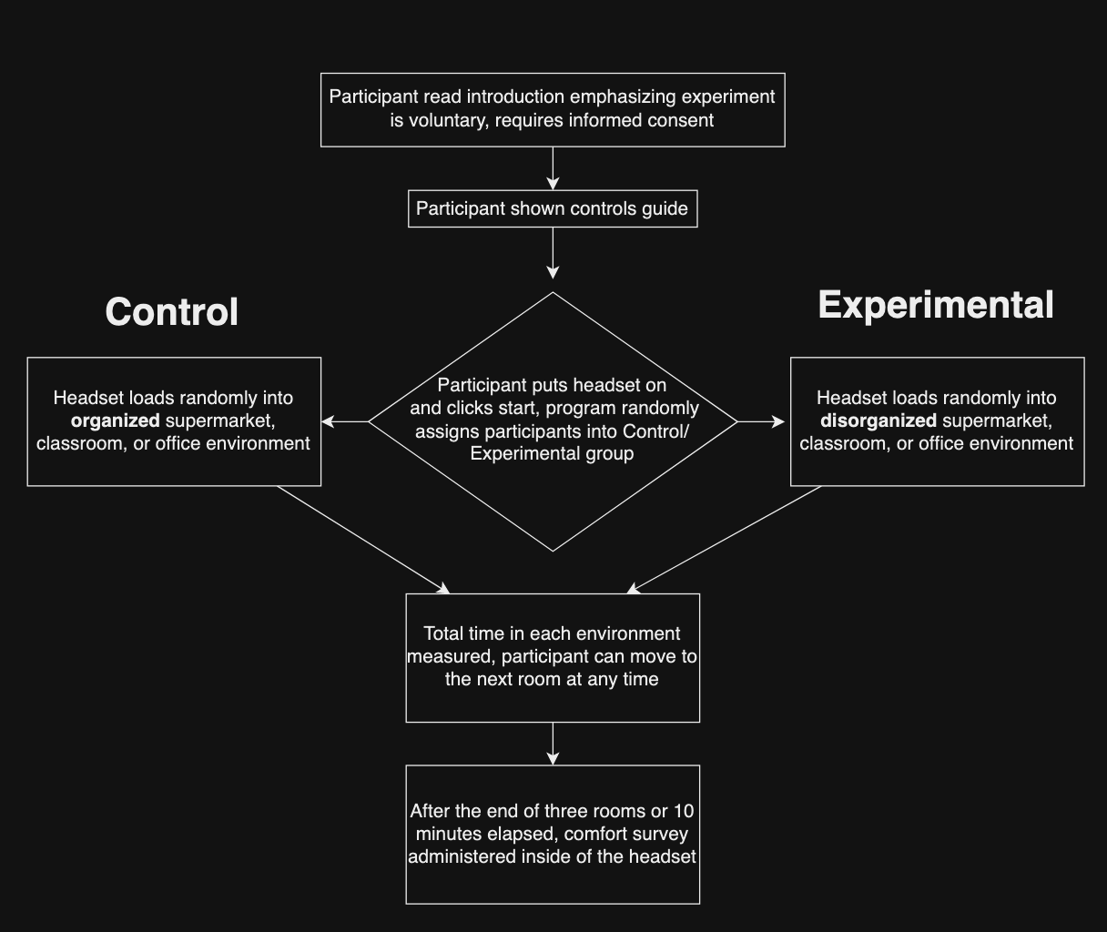
Procedure

Slide 10
Data analysis using Unity Experiment Framework (UXF)
Following slides about UXF adapted from Dr. Jack Brookes, a researcher who created UXF

Slide 11
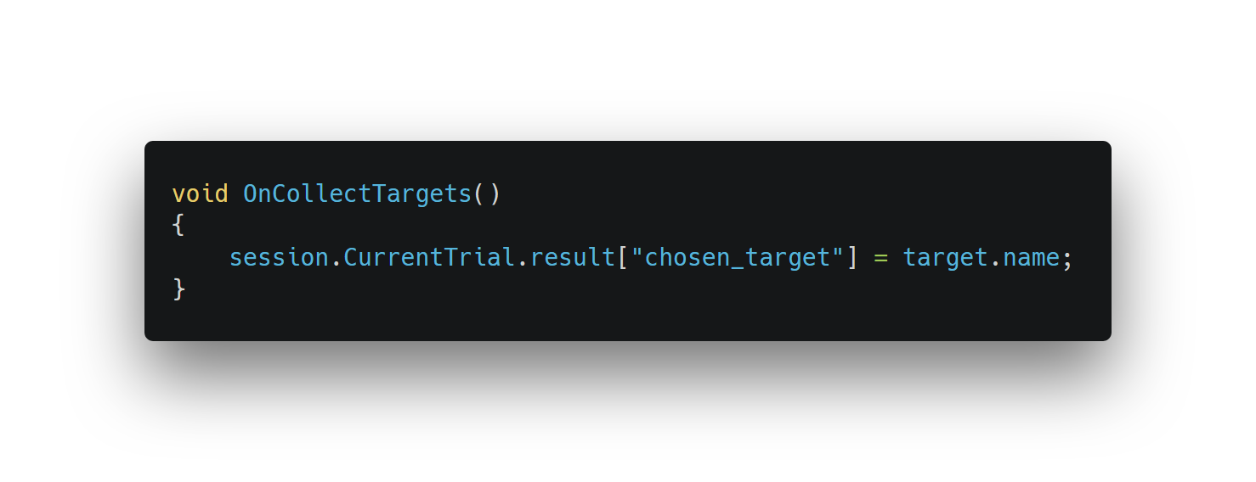
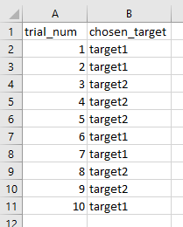
UXF integrates with Unity to allow us to:
Record a response on each trial
  Useful for collecting time data in each liminal space
Automatically outputs properly formatted CSV
‹#›

Slide 12
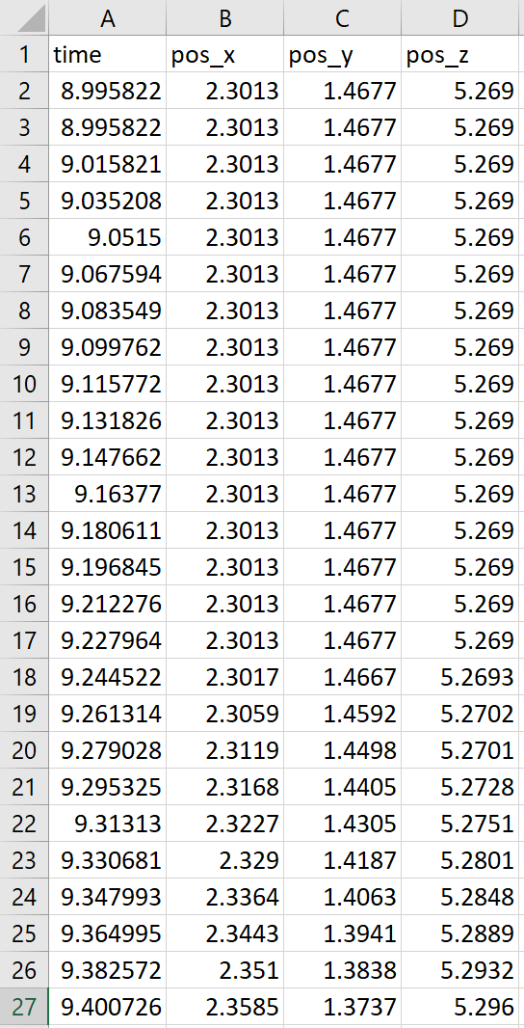
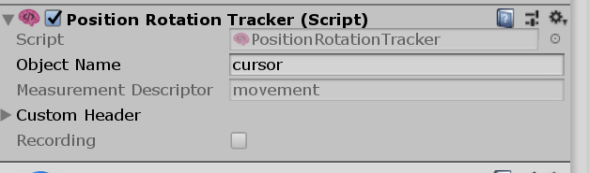
We can also attach a script to a component in the game and collect data per-timestep
Pre-built component for tracking position & rotation
  might be useful for head/eye tracking, object-specific data that we might find useful for gauging “discomfort”
‹#›

Slide 13

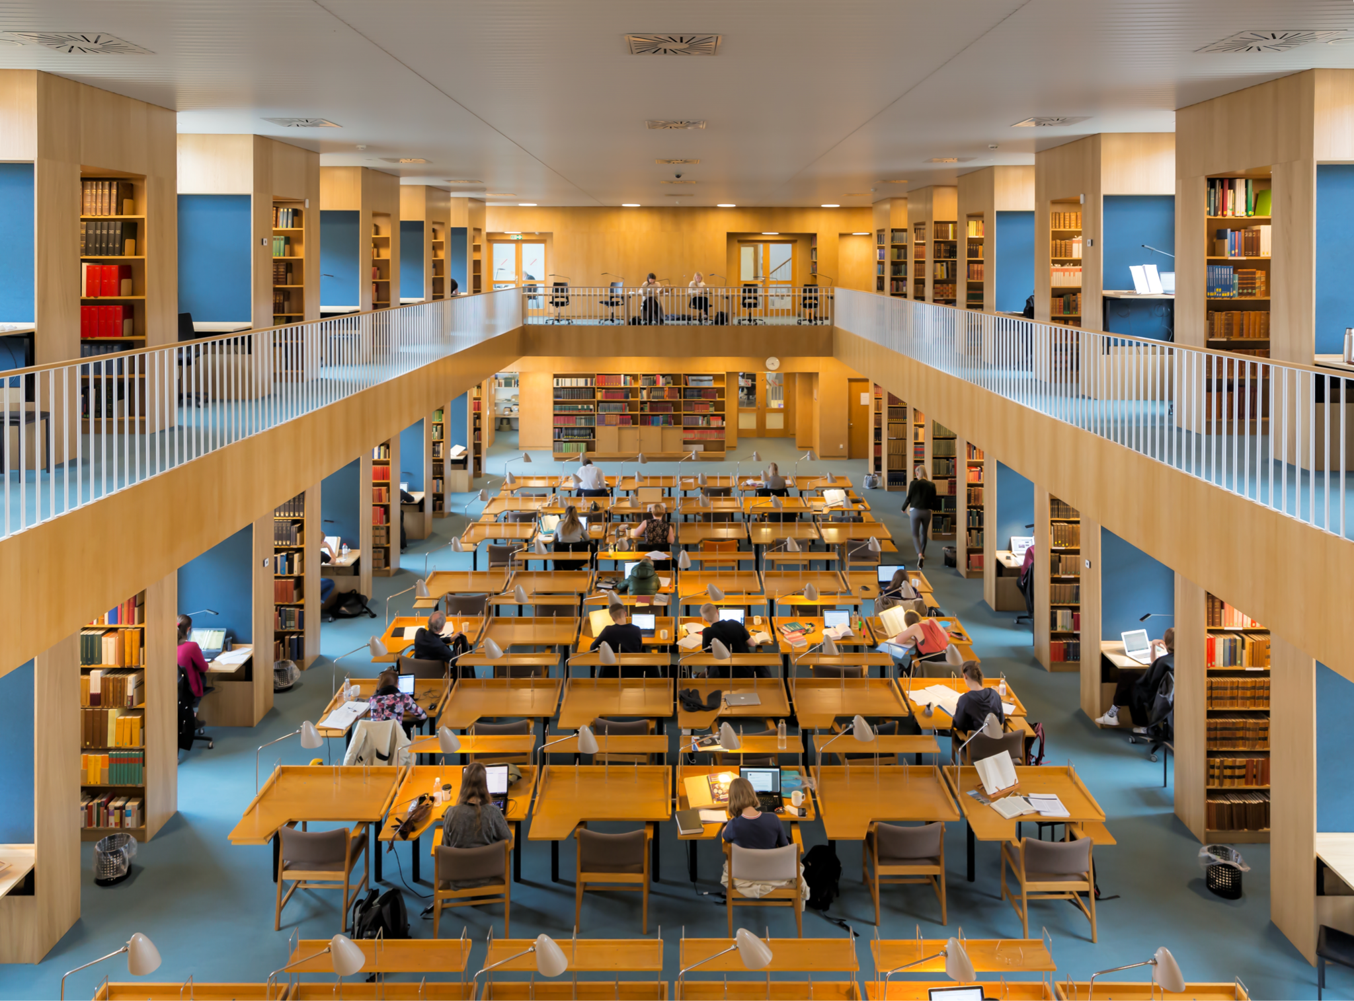
Real World Application
Coming back from COVID-19
Creating optimized spaces
Comfort for students or office workers
Notes:
Talk about optimized spaces commercially, in school, and at home which may increase productivity

Slide 14


What’s Next?
ISTE competition
ISEF presentation playground
Additional avenues of study
Notes:
For Additional Avenues of Study talk about productiveness and maybe space space connection

Slide 15

Thank You!

